Slide 1
20XC15 - Problem Solving and C Programming
Structures and Unions

Slide 2
Outline
Structures – Introduction
Definition
Accessing a structure
Initializing a struct variable
Assigning values to a structure variable
Reading inputs
Array of structures
Array as structure member
Nesting of structures
Typedef
Structures and Pointers

Slide 3
Structures - Introduction
Structures - sometimes referred to as aggregates in the C standard - are collections of related variables under one name
Structures may contain variables of many different data types - in contrast to arrays, which contain only elements of the same data type
Structures are commonly used to define records to be stored in files
Structures are derived data types - they’re constructed using objects of other types

Slide 4
Structures
It is a convenient tool for handling a group of logically related data items
  Examples
    Student name, roll number, and marks
    Real part and complex part of a complex number
Helps in organizing complex data in a more meaningful way
The individual structure elements are called members

Slide 5

Structure Definitions
Structure Declaration
struct tag {
member 1;
member 2;
…..
member m;
};
struct is the required C keyword
tag is the name of the structure
member 1, member 2, … are individual member declarations

Slide 6
Structure Definitions
The individual members can be ordinary variables, pointers, arrays, or other structures (any data type)
  The member names within a particular structure must be distinct from one another
  A member name can be the same as the name of a variable defined outside of the structure
Once a structure has been defined, the individual structure-type variables can be declared as:
struct tag var_1, var_2, …, var_n;

Slide 7
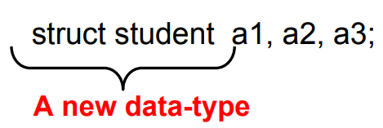
Structure Definition
struct student {
char name[30];
int roll_number;
int total_marks;
char dob[10];
};
Defining structure variables

Slide 8
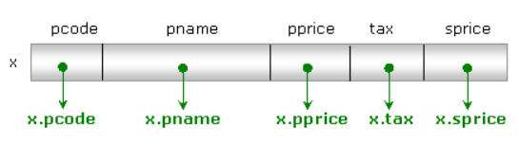
Structure Definition
struct product {
int pcode;
char pname[20];
float pprice;
float tax;
float sprice;
};
Defining structure variables
struct product X;

Slide 9
A Compact Form
It is possible to combine the declaration of the structure with that of the structure variables:
struct tag {
member 1;
member 2;
……..
member m;
} var_1, var_2,…, var_n;
Declares three variables of type struct tag
In this form, tag is optional

Slide 10
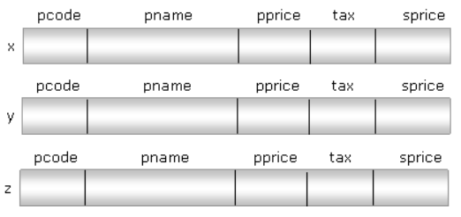
Structure Definition
struct product {
int pcode;
char pname[20];
float pprice;
float tax;
float sprice;
} x, y, z;

Slide 11
Accessing a Structure
The members of a structure are processed individually, as separate entities
  Each member is a separate variable
A structure member can be accessed by writing variable.member where variable refers to the name of a structure-type variable, and member refers to the name of a member within the structure
Examples
a1.name
a2.name
a1.roll_number
a3.dob
struct student {
char name[30];
int roll_number;
int total_marks;
char dob[10];
};

Slide 12
Accessing a Structure
Note:
dot (.) operator is a member of the highest precedence group, this operator takes precedence over the unary operators as well as the various arithmetic, relational, logical and assignment operators
The expression ++ variable.member is equivalent to
++(variable.member)
Similarly, the expression &variable.member is equivalent to
&(variable.member)

Slide 13
Example: Complex number Addition
#include<stdio.h>
int main()
{
struct complex
{
float real;
float cmplex;
} a, b, c; // a, b, and c are local structure variables
scanf (“%f %f”, &a.real, &a.cmplex);
scanf (“%f %f”, &b.real, &b.cmplex);
c.real = a.real + b.real;
c.cmplex = a.cmplex + b.cmplex;
printf (“\n %f + %f j”, c.real, c.cmplex);
}

Slide 14

Initializing a struct variable
Structure variables may be initialized following similar rules of an array. The values are provided within the braces separated by commas
struct product {
int pcode;
char pname[20];
float price;
int qty;
float bill;
};
While initializing a set of values to the struct variable make sure that, the order of values must match with the order of members in the struct definition
struct product a={1000,"cock",25.50,2,51.00};

Slide 15
Initializing a struct variable
struct box {
int b;
int w;
int h;
};
struct box x={0}; // all the members of struct variable “x” are initialized with 0s
struct box y={1}; // only the first member is initialized with 1 and other members are initialized with 0s

Slide 16
Initializing a struct variable
#include<stdio.h>
struct box
{
int b;
int w;
int h;
} x={0}; // Global
int main()
{
struct box y={1}; //Local
printf("Sides of first box %d\t%d\t%d",x.b, x.w, x.h);
printf("\nSides of second box %d\t%d\t%d",y.b, y.w, y.h);
return 0;
}
Output
Sides of first box 0 0 0
Sides of second box 1 0 0

Slide 17
Initializing a struct variable
The initialization sequence can be changed by specifying the name of member in initialization statement
struct box x={.w=20,.b=10,.h=45};
Here, the first member “b” is initialized with 10, the second member “w” is initialized with 20 and the third member “h” is initialized with 45
struct box x={.w=20};
Here only the second member “w” is initialized with 20, first and third members “b”, “h” are initialized with zeros

Slide 18
Initializing a struct variable
#include<stdio.h>
struct box
{
int b;
int w;
int h;
};
int main()
{
struct box x={.w=20,.b=10,.h=45};
struct box y={.w=20};
printf("Sides of first box %d\t%d\t%d",x.b, x.w, x.h);
printf("\nSides of second box %d\t%d\t%d",y.b, y.w, y.h);
return 0;
}
Output
Sides of first box 10 20 45
Sides of second box 0 20 0

Slide 19
Initializing a struct variable
Note:
The individual member cannot be initialized within a structure type declaration
struct box {
int b = 0; // error
int w;
int h;
};
A storage class cannot be assigned to an individual member

Slide 20
Initializing a struct variable
Each structure is a self-contained entity. The same member name can be used in different structures to represent different data
  Ie., the scope of a member is confined to the particular structure within which it is defined
  struct first
  {
  float a;
  int b;
  char c;
  };
  struct second
  {
  float a;
  char c;
  };

Slide 21
Assignment
struct product {
int pcode;
char pname[20];
float price;
int qty;
float bill;
} p1;
p1.pcode = 101;
strcpy (p1.pname, “PEN”); // p1.pname = “PEN” – is an error
p1.price =10;
p1.qty = 1000;

Slide 22

Assignment
#include<stdio.h>
struct
{
int x;
int y;
}p;
int main()
{
p.x=10;
p.y=20;
printf("x=%d\ny=%d",p.x,p.y);
return 0;
}
Output
x=10
y=20

Slide 23
Reading Input
#include<stdio.h>
struct employee
{
int empno;
char ename[50];
int sal;
float hra,da,gross;
};
int main()
{
struct employee x;
printf("Empno:");
scanf("%d",&x.empno);
printf("Employee Name:");
scanf("%s",x.ename);
printf("Salary:");
scanf("%d",&x.sal);
x.hra=(float)x.sal*13/100;
x.da=(float)x.sal*15/100;
x.gross=x.sal+x.hra+x.da;
printf("\nPay Slip Details:\n");
printf("Empno:%d\n",x.empno);
printf("Employee Name:%s\n",x.ename);
printf("Salary:%d\n",x.sal);
printf("House Rent Allowance: %f\n",x.hra);
printf("Dearness Allowance: %f\n",x.da);
printf("Gross Salary: %f\n",x.gross);
return 0;
}

Slide 24

Reading Input
Execution:
Empno:1000
Employee Name:Smith
Salary:7500
Pay Slip Details:
Empno:1000
Employee Name:Smith
Salary:7500
House Rent Allowance: 975.000000
Dearness Allowance: 1125.000000
Gross Salary: 9600.000000

Slide 25
Operations on Structure Variables
Unlike arrays, a structure variable can be directly assigned to another structure variable of the same type
a1 = a2;
All the individual members get assigned
Two structure variables cannot be compared for equality or inequality
if (a1 == a2)…… //this cannot be done

Slide 26
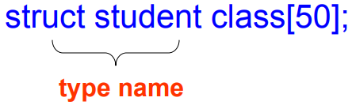
Array of Structures
Once a structure has been defined, we can declare an array of structures
Array of structures – is an array in which each element is a structure
The individual members can be accessed as:
class[i].name
class[5].roll_number

Slide 27
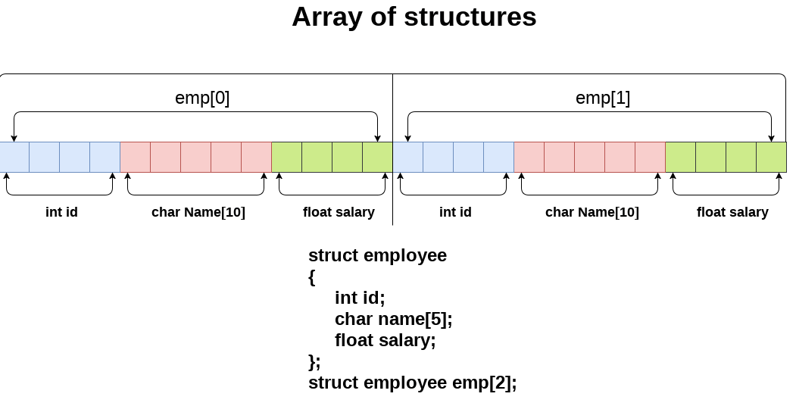

Slide 28
Array of Structures
If we want to handle the details of “n” entities then it is a good idea to declare an array of struct type rather declaring multiple variables because it improves the flexibility in program development
struct product
{
int sno;
char pname[50];
float price;
int qty;
float tot;
};
int main()
{
struct product x[5];
……….
}
struct product
{
int sno;
char pname[50];
float price;
int qty;
float tot;
}x[5];

Slide 29
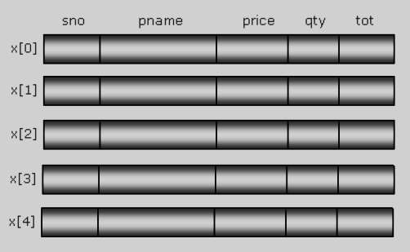
Array of Structures
struct product x[5];
x[5] is an array of “struct product” type where every element of array has all the members of “product” and capable of storing the details of a product

Slide 30
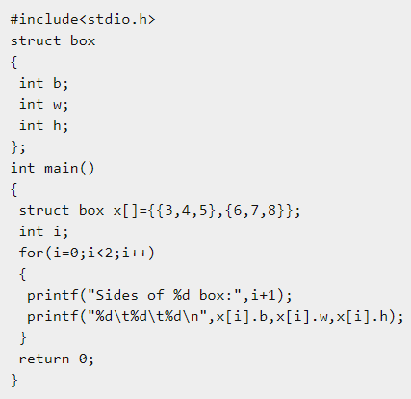
Array of Structures
Array of structures can be initialized while declaration like a set of sets of values
struct box x[ ]={
{3,4,5},
{6,7,8}
};

Slide 31
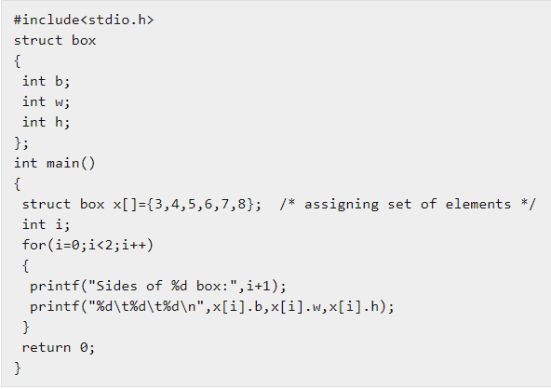

Array of Structures

Slide 32
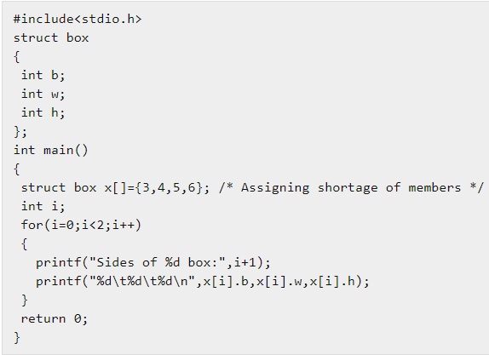

Array of Structures
If enough initial values are not supplied then remaining members would be initialized with 0s

Slide 33
Array of Structures
Details of 5 products can be obtained using a loop
for(i=0;i<5;i++)
{
scanf("%d",&x[i].pcode);
scanf("%s", x[i].pname);
scanf("%f", &x[i].price);
scanf("%d", &x[i].qty);
x[i].bill=x[i].price*x[i].qty;
}

Slide 34
Array of Structures
#include<stdio.h>
struct product
{
int sno;
char pname[50];
float price;
int qty;
float tot;
};
int main()
{
struct product x[50];
int i,n;
float bill,temp;
printf("How many products?");
scanf("%d",&n);
printf("Enter the details of %d products:\n",n);
for(i=0;i<n;i++)
{
x[i].sno=i+1;
printf("\nName:");
scanf("%s",x[i].pname);
printf("Price:");
scanf("%f",&temp);
x[i].price=temp;
printf("Quantity:");
scanf("%d",&x[i].qty);
x[i].tot=x[i].price*x[i].qty;
}

Slide 35
Array of Structures
printf("\n\n XYZ SUPER BAZAR\n");
printf("-----------------------------------------------------------------\n");
printf("Sno Name Price Qty Total \n");
printf("-----------------------------------------------------------------\n");
bill=0;
for(i=0;i<n;i++)
{
printf("%d\t%s\t\t%f\t%d\t%f\n",x[i].sno,x[i].pname,x[i].price,x[i].qty,x[i].tot);
bill=bill+x[i].tot; /* Adding totals to bill */
}
printf(" -----------------\n");
printf(" %f\n",bill);
printf(" -----------------\n");
return 0;
}

Slide 36
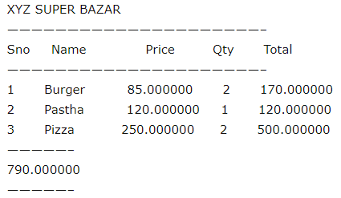
Array of Structures
Execution:
How many products?3
Enter the details of 3 products:
Name:Burger
Price:85
Quantity:2
Name:Pastha
Price:120
Quantity:1
Name:Pizza
Price:250
Quantity:2

Slide 37
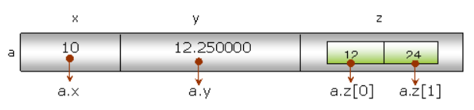
Array as struct member
#include<stdio.h>
struct data
{
int x;
float y;
int z[2];
};
int main()
{
struct data a ={10, 12.25f, 12, 24};
//a.x=10;
//a.y=12.25f;
//a.z[0]=12;
//a.z[1]=24;
printf("x=%d",a.x);
printf("\ny=%f",a.y);
printf("\nArray elements %d\t%d",a.z[0],a.z[1]);
return 0;
}
Output
x=10
y=12.250000
Array elements 12 24

Slide 38
Nested Structure in C
C provides us the feature of nesting one structure within another structure
#include<stdio.h>
struct data
{
int x;
struct
{
int y;
int z;
}p;
};
int main()
{
struct data a;
a.x=10;
a.p.y=20;
a.p.z=30;
printf("x=%d\ny=%d\nz=%d",a.x, a.p.y, a.p.z);
return 0;
}

Slide 39
Nested Structure in C
struct point
{
int y;
int z;
};
struct data
{
int x;
struct point p;
};
int main()
{
struct data a;
a.x=10;
a.p.y=20;
a.p.z=30;
printf("x=%d\ny=%d\nz=%d",a.x, a.p.y, a.p.z);
return 0;
}

Slide 40
USER-DEFINED DATA TYPES (typedef)
The typedef feature allows users to define new data types that are equivalent to existing data types
Once a user-defined data type has been established, then new variables, arrays, structure and so on, can be declared in terms of this new data type.
In general terms, a new data type is defined as
typedef type new type;
where type refers to an existing data type and new-type refers to the new user-defined data type
e.g. typedef int age;
In this declaration, age is user- defined data type equivalent to type int.

Slide 41
USER-DEFINED DATA TYPES (typedef)
typedef int age;
Hence, the variable declaration
age male, female;
is equivalent to writing
int male, female;
The typedef feature is particularly convenient when defining structures, since it eliminates the need to repeatedly write struct tag whenever a structure is referenced
Syntax
typedef struct {
member 1;
member 2;
- - - - - - - -
member m;
}new-type;

Slide 42
typedef : An example
typedef struct {
float real;
float imag;
} COMPLEX;
COMPLEX is the name of the new data-type … - Also called an alias for struct
Writing the tag name is optional, can be skipped …
Naming follows rules of variable naming
Defined a new data type named COMPLEX. Now can declare and use variables of this type
COMPLEX a, b, c;

Slide 43
typedef : An example
Note:
typedef is not restricted to just structures, can define new types from any existing type
„ Example:
… typedef int INTEGER
… Defines a new type named INTEGER from the known type int
… Can now define variables of type INTEGER which will have all properties of the int type
INTEGER a, b, c;

Slide 44
typedef : An example
#include<stdio.h>
typedef struct {
char title[20];
char publisher[20];
char author[20];
int year;
int pages;
} Book;
int main()
{
Book b1 = {
"The Zahir",
"Harper Perennial" ,
"Paulo Coelho",
2005,
336 };
printf("Title: %s\n", b1.title);
printf("Author: %s\n", b1.author);
return 0;
}

Slide 45
Structures and Pointers
The beginning address of a structure can be accessed in the same manner as any other address, through & operator
Syntax : declaring a pointer variable for a structure
type *ptr;
Syntax : assigning the beginning address of a structure variable to a pointer
ptr = &variable;
Example
typedef struct {
int acc_type;
int acc-no;
char name[30];
float balance;
} account;
int main( )
{
account customer, *p;
p=&customer;
………….

Slide 46
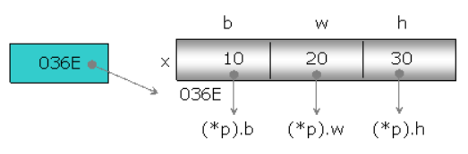
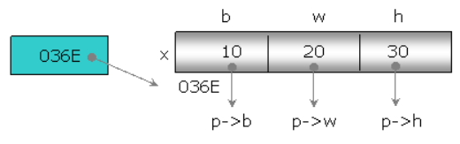
Structures and Pointers
To store the address of a struct variable, the pointer must be of the same struct type
struct box x={10,20,30}, *p;
p=&x;
“p” is the pointer to the struct variable “x”, “P” could refer every member of struct variable “x” using indirection operator * (value at)
*p refers the total struct variable and by which we can refer individual members as (*p).b, (*p).w and (*p).h

Slide 47
Structures and Pointers
#include<stdio.h>
struct box
{
int b;
int w;
int h;
};
int main()
{
struct box x={10,20,30};
struct box *p;
p=&x;
printf("Three sides of box: %d\t%d\t%d",(*p).b,(*p).w,(*p).h);
return 0;
}
Output:
Three sides of box: 10 20 30

Slide 48
Structures and Pointers
C provides the structure pointer operator -> to access members of a structure via a pointer
  -> is typed on the keyboard as a minus sign followed by a greater than sign
If a pointer variable is assigned the address of a structure, then a member of the structure can be accessed by:
  pointer-to-structure -> member_name
  An equivalent construct is:
  (*pointer_to_structure). member_name

Slide 49
Example of the two Accessing modes
  struct student temp, *p = &temp;
  temp.grade = ‘A’;
  strcpy(temp.last_name, “Bushker”);
  temp.student_id = 590017;
Expression Equivalent Expression Conceptual Value
temp.grade p -> grade A
temp.last_name p -> last_name Bushker
temp.student_id p -> student_id 590017
(*p).student_id p -> student_id 590017

Slide 50
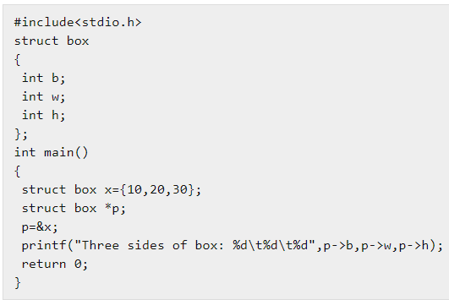

Structures and Pointers

Slide 51
Structures and Pointers
Accept the radius of a circle and print the area and circumference using pointer
int main()
{
p=&x;
printf("Enter the radios:");
scanf("%d", &(p->rad));
p->area = PI*(p->rad)*(p->rad);
p->cir = 2*PI *(p->rad);
printf("Area %f", p->area);
printf("\nCircumference %f", p->cir);
return 0;
}
#include<stdio.h>
#define PI 3.14
struct circle
{
int rad;
float area,cir;
} x,*p;
Output:
Enter the radios:15
Area 706.500000
Circumference 94.199997

Slide 52
Structures and Pointers
struct
{
int acc_no;
int acc_type;
char name[80];
float balance;
date lastpayment;
} customer, *pc=&customer;
If we want to access the customer’s account number, we could write any of the following:
  customer.acc_no=10;
  pc->acc_no=10;
  (*pc).acc_no=10;
typedef struct
{
int month;
int day;
int year;
}date;

Slide 53
Structures and Pointers
The customer’s balance can be accessed by
  customer. balance=50000.00
  pc->balance=50000.00
  (*pc).balance=50000.00
  The month of the last payment can be accessed by
  customer.lastpayment.month=12
  pc->lastpayment.month=12
  (*pc).lastpayment.month=12
The customer’s name can be accessed by
  customer.name
  pc->name
  (*pc).name

Slide 54
Structures and Pointers
A structure can also include one or more pointers as members
*variable.ptmember – to access a structure member which is a pointer using a normal structure variable
*ptvar->ptmember – to access a structure member which is a pointer using a pointer to a structure
#include<stdio.h>
main()
{ int n=3333;
char t=‘c’;
float b=99.99;
typedef struct{
int month;
int day;
int year;
}date;

Slide 55
Structures and Pointers
struct
{
int *acc_no;
int *acc_type;
char *name;
float *balance;
date lastpayment;
} customer, *pc=&customer;
customer.acc_no=&n;
customer.acc_type=&t;
customer.name=“smith”;
customer.balance=&b;
printf(“%d,%c,%s,%.2f”, *customer.acc_no,*customer.acc_type, customer.name,*customer.balance);
printf(“%d,%c,%s,%.2f”, *pc->acc_no,*pc->acc_type, pc->name,*pc->balance);
Output:
c smith 99.99
3333 c smith 99.99

Slide 56
Passing Structures to Functions
There are several different ways to pass structure type information to or from a function
Structure members can be transferred individually or entire structures can be transferred
Passing individual members as arguments
  Call by value
  Call by address
Passing entire structure as argument
  Call by value
  Call by address

Slide 57
Passing Individual members as Arguments – Call by value
#include<stdio.h>
struct student
{
char name[20];
int roll_no;
int marks;
};
void print_struct(char name[ ], int roll_no, int marks);
int main()
{
struct student stu = {"Tim", 1, 78};
print_struct(stu.name, stu.roll_no, stu.marks);
return 0;
}
void print_struct(char name[ ], int roll_no, int marks)
{
printf("Name: %s\n", name);
printf("Roll no: %d\n", roll_no);
printf("Marks: %d\n", marks);
printf("\n");
}

Slide 58
Passing Individual members as Arguments – Call by Address
#include<stdio.h>
struct student
{
char name[20];
int roll_no;
int marks;
};
void print_struct(char *name, int *roll_no, int *marks);
int main()
{
struct student stu = {"Tim", 1, 78};
print_struct(stu.name, &stu.roll_no, &stu.marks);
return 0;
}
void print_struct(char *name, int *roll_no, int *marks)
{
printf("Name: %s\n", name);
printf("Roll no: %d\n", *roll_no);
printf("Marks: %d\n", *marks);
printf("\n");
}

Slide 59
Passing structure variable as argument to a function – Call by value
While sending a struct variable as argument make sure that, the type of formal argument must be the type of actual argument (struct type) and struct definition must be visible to both the calling and called by function
void display(struct book b1)
{
printf("Book Name:%s", b1.name);
printf("\nAuthor: %s", b1.author);
printf("\nPublisher: %s", b1.publisher);
printf("\nPrice:%f", b1.price);
}
struct book
{
char name[50];
char author[50];
char publisher[50];
float price;
};
void display(struct book);
int main()
{
struct book x={"Let us C","Kanithkar","BpB",275};
display(x);
return 0;
}
Output:
Book Name:Let us c
Author: Kanithkar
Publisher: BpB
Price:275.000000

Slide 60
Passing structure variable as argument to a function
int main ()
{
struct comp a = {1.1,2.2}, b = {2.4,-3.6}, c;
c = cmul(a,b);
printf("product = (%f)+i(%f)\n", c.real, c.imag);
}
#include <stdio.h>
struct comp {
float real;
float imag;
};
struct comp cmul ( struct comp z1 , struct comp z2 )
{
struct comp z;
z.real = (z1.real) * (z2.real) - (z1.imag) * (z2.imag);
z.imag = (z1.real) * (z2.imag) + (z1.imag) * (z2.real);
return z;
}

Slide 61
Passing Pointer to a structure as argument to a function
include<stdio.h>
#define PI 3.14
struct circle
{
int rad;
float area,cir;
};
void calculate(struct circle*);
int main()
{
struct circle x;
printf("Enter the radios:");
scanf("%d",&x.rad);
calculate(&x);
printf("Area of circle %f",x.area);
printf("\nCircumference of circle %f",x.cir);
return 0;
}
void calculate(struct circle *p) /* pointer to struct variable */
{
p->area=PI*(p->rad)*(p->rad);
p->cir=2*PI*(p->rad);
}
Execution:
Enter the radios: 17
Area of circle 907.460022
Circumference of circle 106.760002

Slide 62
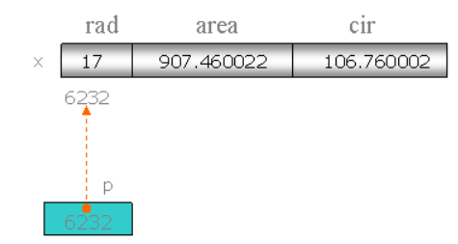
Passing Pointer to a structure as argument to a function

Slide 63
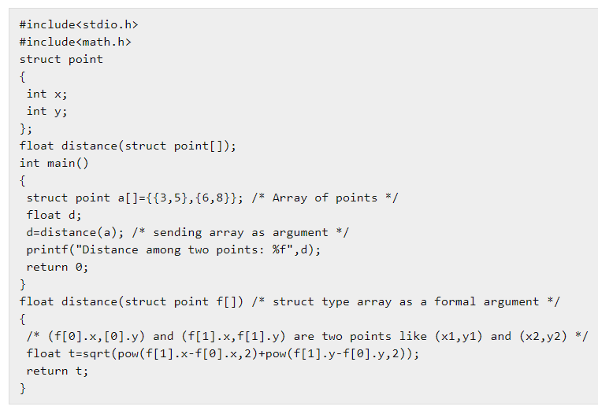
Passing array of Structures as argument to a function
Like a struct variable, even we can send an array of struct type as argument. Here we specify the name of array as actual argument and the same type of struct array as a formal argument
Output
Distance among two points: 4.242640

Slide 64
Passing Array of Structures as argument to a function
#include<stdio.h>
struct company
{
char name[20];
char ceo[20];
float revenue; // in $
float pps; // price per stock in $
};
void print_struct(const struct company str_arr[ ]);
int main()
{
struct company companies[3] = {
{"Country Books", "Tim Green", 999999999, 1300 },
{"Country Cooks", "Jim Green", 9999999, 700 },
{"Country Hooks", "Sim Green", 99999, 300 },
};
print_struct(companies);
return 0;
}

Slide 65
Passing Array of Structures as argument to a function
void print_struct(struct company str_arr[])
{
int i;
for(i= 0; i<3; i++)
{
printf("Name: %s\n", str_arr[i].name);
printf("CEO: %d\n", str_arr[i].ceo);
printf("Revenue: %.2f\n", str_arr[i].revenue);
printf("Price per stock : %.2f\n", str_arr[i].pps);
printf("\n");
}
}

Slide 66
Returning a struct variable from a function
Like any variable, even a struct variable can be returned from a function
#include<stdio.h>
#include<math.h>
struct point
{
int x;
int y;
};
struct point getpoint();
int main()
{
struct point p;
p=getpoint();
printf("x=%d\ny=%d",p.x,p.y);
return 0;
}
struct point getpoint()
{
struct point a={43,56};
return a; /* returning the struct variable */
}
Output
x=43
y=56

Slide 67
Returning the address of a struct variable
We can return the address of a struct variable to the calling function so that the calling function can access the struct variable of called by function using indirection
#include<stdio.h>
#include<math.h>
struct point
{
int x;
int y;
};
struct point* getref();
int main()
{
struct point *p;
p=getref();
printf("x=%d\ny=%d",p->x,p->y);
return 0;
}
struct point* getref()
{
struct point a={43,56};
return &a; /* returning the address of local variable */
}
$gcc demo.c
demo.c in function 'getref'
demo.c : Warning : function returns address of local variable
$./a.out
x=43
y=56

Slide 68
Returning the address of a struct variable
Here the program is successfully executed but, compiler is throwing a warning because the local variable “a” belongs to getref() will be de-allocated once the execution of function is completed and return to the main()
It can be rectified by defining the local variable as static so that, the scope of struct variable will be extended along the program. To get rid of warning, we can define the function as
struct point* getref()
{
static struct point a={43,56};
return &a; /* returning the address of local variable */
}

Slide 69
Self Referential Structures
Self Referential structures are those structures that have one or more pointers which point to the same type of structure, as their member
struct node {
int data1;
char data2;
struct node* link;
};
int main()
{
struct node ob;
return 0;
}
‘link’ is a pointer to a structure of type ‘node’. Hence, the structure ‘node’ is a self-referential structure with ‘link’ as the referencing pointer

Slide 70
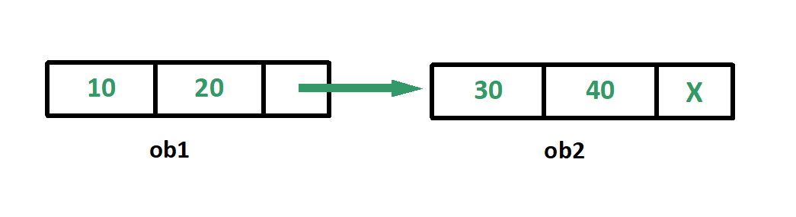
Self Referential Structures
#include <stdio.h>
struct node {
int data1;
char data2;
struct node* link;
};
int main()
{
struct node ob1; // Node1
// Initialization
ob1.link = NULL;
ob1.data1 = 10;
ob1.data2 = 20;
struct node ob2; // Node2
// Initialization
ob2.link = NULL;
ob2.data1 = 30;
ob2.data2 = 40;
// Linking ob1 and ob2
ob1.link = &ob2;
// Accessing data members of ob2 using ob1
printf("%d", ob1.link->data1);
printf("\n%d", ob1.link->data2);
return 0;
}
Output:
30
40

Slide 71
Structure Padding in C
Structure padding is a concept in C that adds the one or more empty bytes (slack bytes) between the memory addresses to align the data in memory
A contiguous block of memory is allocated to its structure members. First, the memory will be allocated to the 'a' variable, then 'b' variable, and then 'c' variable
struct student
{
char a; // 1 byte
char b; // 1 byte
int c; // 4 bytes
} stud1;

Slide 72
Structure Padding in C
Size of the structure student – 6 bytes ??? - Wrong
Size of the structure student – 8 bytes
Reason : The processor does not read 1 byte at a time. It reads 1 word at a time
  If we have a 32-bit processor, then the processor reads 4 bytes at a time, which means that 1 word is equal to 4 bytes
  If we have a 64-bit processor, then the processor reads 8 bytes at a time, which means that 1 word is equal to 8 bytes

Slide 73
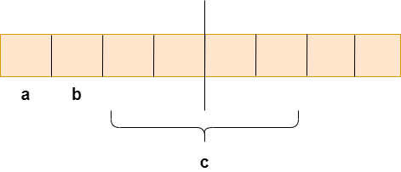
Why Structure Padding?
struct student
{
char a; // 1 byte
char b; // 1 byte
int c; // 4 bytes
} ;
If we have a 32-bit processor (4 bytes at a time), then the pictorial representation of the memory for the above structure would be
If structure occupies the contiguous block of memory as shown in the above diagram, i.e., 1 byte for char a, 1 byte for char b, and 4 bytes for int c, then what problem does it cause?

Slide 74
Why Structure Padding?
The 4-bytes can be accessed at a time considering the 32-bit architecture
The problem is that in one CPU cycle, one byte of char a, one byte of char b, and 2 bytes of int c can be accessed
char a and char b are char variables and can be accessed in one CPU cycle, but to access int c, 2 CPU cycles are required to access the value of the 'c' variable
  In the first CPU cycle, the first two bytes are accessed, and in the second cycle, the other two bytes are accessed
In computers, speed is a very important factor. We always try to make designs and algorithms in such a way that the access to the memory is much faster

Slide 75
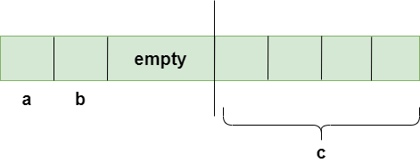
Why Structure Padding?
Suppose we do not want to access the 'a' and 'b' variable, we only want to access the variable 'c', which requires two cycles. The variable 'c' is of 4 bytes, so it can be accessed in one cycle also, but in this scenario, it is utilizing 2 cycles.
This is an unnecessary wastage of CPU cycles. Due to this reason, the structure padding concept was introduced to save the number of CPU cycles. The structure padding is done automatically by the compiler.
How is structure padding done?
Now, variable ‘c’ can be accessed in a single CPU cycle
After structure padding, the total memory occupied by the structure is 8 bytes (1 byte+1 byte+2 bytes+4 bytes)

Slide 76
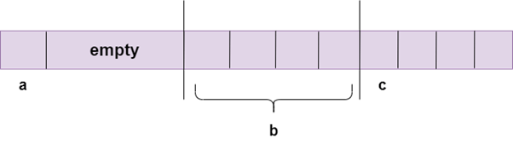
Changing the order of the variables
include <stdio.h>
struct student
{
char a;
int b;
char c;
};
int main()
{
struct student stud1;
printf("The size of the student structure is %d", sizeof(stud1));
return 0;
}
Due to the change in the order, the output would be different in both the cases. In the previous case, the output was 8 bytes, but in this case, the output is 12 bytes

Slide 77
How to avoid the structure padding in C?
The structural padding is an in-built process that is automatically done by the compiler
Sometimes it required to avoid the structure padding in C as it makes the size of the structure greater than the size of the structure members
To avoid the structure padding in C
#include <stdio.h>
#pragma pack(1)
struct base
{
int a;
char b;
double c;
};
int main()
{
struct base var;
printf("The size of the var is : %d", sizeof(var));
return 0;
}
Output : The size of the var is 6

Slide 78
Unions
Like structure, Union is used to store the elements of different types
Syntax : Declaration of union
Union variable Definition
union tag var1, var2, …, varn;
union tag
{
data_type member1;
data_type member2;
.
.
data_type memeberN;
};
union tag
{
data_type member1;
data_type member2;
.
.
data_type memeberN;
} var1, var2, …, varn;

Slide 79
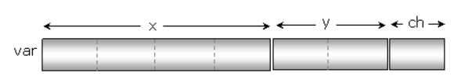
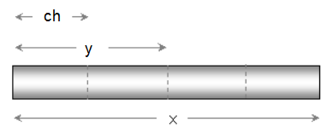
Unions
Like a structure, even a union can have different members of different types
Difference - the memory allocation of members
struct demo
{
float x;
short y;
char ch;
};
struct demo var;
union demo
{
float x;
short y;
char ch;
};
union demo var;

Slide 80
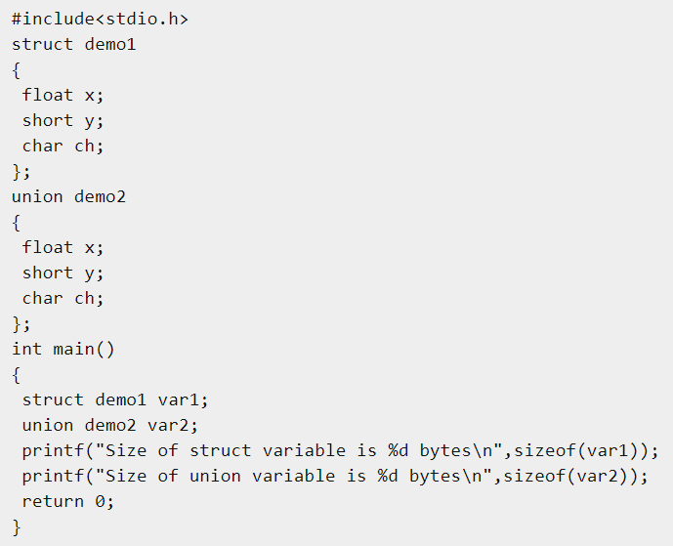
Unions
Output:
Size of struct variable 7 bytes
Size of union variable 4 bytes

Slide 81
Initializing Union Variable
We can only initialize one of the members of the union at the time of declaration and this privilege goes to the first member
For example
This statement initializes the union variable u1. ie., it initializes only the first member of the union variable u1
union data
{
int var1;
double var2;
char var3;
};
union data u1 = {10};
Designated Initializer
union data u2 = {.var2 = 9.14 };
union data u3 = { .var3 = 'a' };

Slide 82
Unions
Members of union variable use common memory
#include<stdio.h>
union demo
{
short x;
char ch[2];
};
int main()
{
union demo a;
a.x=615;
printf("a.x=%d",a.x);
printf("\na.ch[0]=%c",a.ch[0]);
printf("\na.ch[1]=%c",a.ch[1]);
return 0;
}
Output:
a.x=615
a.ch[0]=garbage value
a.ch[1]=garbage value

Slide 83
Unions
Common memory is used by all the members of union, any single member can be used at a time because assigning value to the second member will result overwriting on the first assigned member
#include<stdio.h>
union num
{
short x;
float y;
};
int main()
{
union num a;
a.x=4526;
a.y=123.986712;
printf("x=%d\n",a.x);
printf("y=%f\n",a.y);
return 0;
}
Output
x= Garbage value
y=123.986712

Slide 84
Unions
Initializing a union variable
We can’t initialize multiple values while declaration of a union variable which results error because only a single member can be assigned at a time
#include<stdio.h>
union num
{
short x;
float y;
};
int main()
{
union num a={40,12.50};
printf("x=%d\n",a.x);
printf("y=%f\n",a.y);
return 0;
}
Output
x=40
y= garbage value

Slide 85
Unions
#include<stdio.h>
union num
{
short x;
float y;
};
int main()
{
union num a={12.50}; //12.5 is initialized to the first member of union
printf("x=%d\n",a.x);
printf("y=%f\n",a.y);
return 0;
}
Output
x=12
y=0.000000

Slide 86
Unions
int main()
{
struct s a;
union u b;
printf("Address variable of a = %u\n", &a);
printf("Size of variable of a = %d\n", sizeof(a));
printf("Address of 1st member i.e var1 = %u\n", &a.var1);
printf("Address of 2nd member i.e var2 = %u\n", &a.var2);
printf("Address of 3rd member i.e var3 = %u\n", &a.var3);
printf("\n");
printf("Address of variable of b = %u\n", &b);
printf("Size of variable of b = %d\n", sizeof(b));
printf("Address of 1st member i.e var1 = %u\n", &b.var1);
printf("Address of 2nd member i.e var2 = %u\n", &b.var2);
printf("Address of 3rd member i.e var3 = %u\n", &b.var3);
printf("\n\n");
return 0;
}
#include<stdio.h>
struct s
{
int var1;
double var2;
char var3;
};
union u
{
int var1;
double var2;
char var3;
};

Slide 87
Unions
Output
  Address variable of a = 2686728
  Size of variable of a = 24 (64 – bit processor)
  Address of 1st member i.e var1 = 2686728
  Address of 2nd member i.e var2 = 2686736
  Address of 3rd member i.e var3 = 2686744
  Address of variable of b = 2686720
  Size of variable of b = 8
  Address of 1st member i.e var1 = 2686720
  Address of 2nd member i.e var2 = 2686720
  Address of 3rd member i.e var3 = 2686720

Slide 88
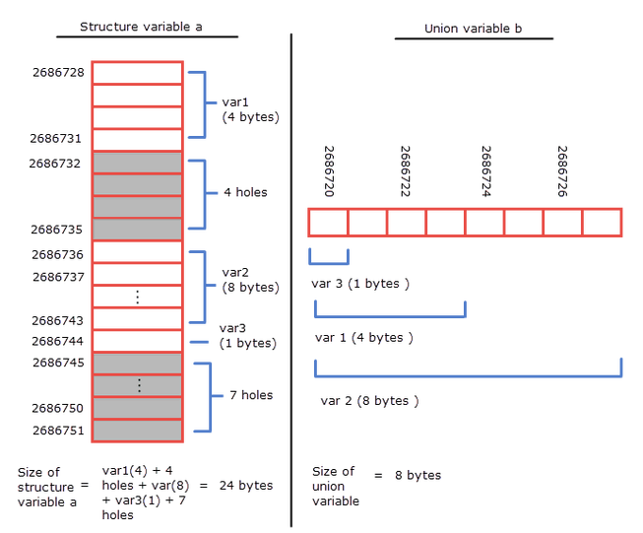

Slide 89
Unions
A structure can be a member one of the union. Similarly, a union can be a member of the structure
union quantity
{
int count;
float weight;
float volume;
};
struct goods
{
char name[20];
union quantity quant;
} g;
struct goods
{
char name[20];
union quantity
{
int count;
float weight;
float volume;
} quant;
} g;
If we want to access the value of count we can write: g.quant.count

Slide 90
Unions
int main()
{
struct goods g1 = { "apple", {.weight=2.5} };
struct goods g2 = { "balls", {.count=100} };
printf("Goods name: %s\n", g1.name);
printf("Goods quantity: %.2f\n\n", g1.q.weight);
printf("Goods name: %s\n", g2.name);
printf("Goods quantity: %d\n\n", g2.q.count);
return 0;
}
#include<stdio.h>
union quantity
{
int count;
float weight;
float volume;
};
struct goods
{
char name[20];
union quantity q;
};
Output:
Goods name: apple
Goods quantity: 2.50
Goods name: balls
Goods quantity: 100

Slide 91

Bit fields
C enables us to specify the number of bits in which an unsigned or int member of a structure or union is stored
This is referred to as a bit field
Bit fields enable better memory utilization by storing data in the minimum number of bits required
Bit field members must be declared as int or unsigned

Slide 92
Bit fields
The general format for declaring bit fields using a structure
struct bitfield_tag
{
unsigned int member1: bit_width1;
unsigned int member2: bit_width2;
.. .
unsigned int memberN: bit_widthN;
};

Slide 93
Bit Fields
Consider the following structure definition
#include <stdio.h>
struct date {
unsigned int d;
unsigned int m;
unsigned int y;
};
int main()
{
printf("Size of date is %lu bytes\n", sizeof(struct date));
struct date dt = { 31, 12, 2014 };
printf("Date is %d/%d/%d", dt.d, dt.m, dt.y);
}
Output:
Size of date is 12 bytes
Date is 31/12/2014

Slide 94
Bit Fields
Since we know that the value of d is always from 1 to 31, the value of m is from 1 to 12, we can optimize the space using bit fields
#include <stdio.h>
struct date {
// d has value between 1 and 31, so 5 bits are sufficient
unsigned int d : 5;
// m has value between 1 and 12, so 4 bits are sufficient
unsigned int m : 4;
unsigned int y;
};
int main()
{
printf("Size of date is %lu bytes\n", sizeof(struct date));
struct date dt = { 31, 12, 2014 };
printf("Date is %d/%d/%d", dt.d, dt.m, dt.y);
return 0;
}
Output
Size of date is 8 bytes
Date is 31/12/2014

Slide 95
Bit Fields
If the same code is written using signed int and the value of the fields goes beyond the bits allocated to the variable and something interesting can happen
#include <stdio.h>
struct date {
// d has value between 1 and 31, so 5 bits are sufficient
int d : 5;
// m has value between 1 and 12, so 4 bits are sufficient
int m : 4;
int y;
};
int main()
{
printf("Size of date is %lu bytes\n", sizeof(struct date));
struct date dt = { 31, 12, 2014 };
printf("Date is %d/%d/%d", dt.d, dt.m, dt.y);
return 0;
}
Output:
Size of date is 8 bytes
Date is -1/-4/2014

Slide 96
Enumeration Constants
C provides an user-defined type called an enumeration
An enumeration, introduced by the keyword enum, is a set of integer enumeration constants represented by identifiers
Values in an enum start with 0, unless specified otherwise, and are incremented by 1
For example, the enumeration
enum months { JAN, FEB, MAR, APR, MAY, JUN, JUL, AUG, SEP,
OCT, NOV, DEC };
creates a new type, enum months, in which the identifiers are set to the integers 0 to 11, respectively

Slide 97
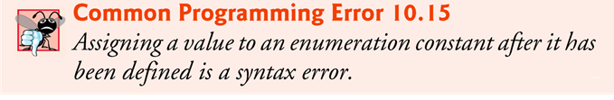
Enumeration Constants
To number the months 1 to 12, use the following enumeration:
enum months { JAN = 1, FEB, MAR, APR, MAY, JUN, JUL, AUG, SEP, OCT, NOV, DEC };
Since the first value in the preceding enumeration is explicitly set to 1, the remaining values are incremented from 1, resulting in the values 1 through 12.
The identifiers in an enumeration must be unique
The value of each enumeration constant of an enumeration can be set explicitly in the definition by assigning a value to the identifier

Slide 98
Enumeration Constants
#include<stdio.h>
enum types { dom,com,agr,ind };
int main()
{
printf("%d\n%d\n%d\n%d\n",dom,com,agr,ind);
return 0;
}
Output
0
1
2
3
#include<stdio.h>
enum types { dom,com=10,agr,ind };
int main()
{
printf("%d\n%d\n%d\n%d\n",dom,com,agr,ind);
return 0;
}
Output
0
10
11
12

Slide 99
Enumeration Constants
enum symbols can’t be explicitly assigned in the program
#include<stdio.h>
enum types { dom,com=10,agr,ind };
int main()
{
dom=45;
agr=55;
ind=60;
printf("%d\n%d\n%d\n%d\n",dom,com,agr,ind);
return 0;
}
Compilation error

Slide 100
Enumeration Constants
Size of enum
#include<stdio.h>
enum types
{
dom,com,agr,ind
};
int main()
{
printf("Size of enum: %d Bytes\n",sizeof(enum types));
return 0;
}
Output
Size of enum: 4 Bytes

Slide 101
Enumeration Constants
Output:
1, 0, 0
Two enum names can have same value
If we do not explicitly assign values to enum names, the compiler by default assigns values starting from 0
#include <stdio.h>
enum State {Working = 1, Failed = 0, Freezed = 0};
int main()
{
printf("%d, %d, %d", Working, Failed, Freezed);
return 0;
}
#include <stdio.h>
enum day {sunday, monday, tuesday, wednesday, thursday, friday, saturday};
int main()
{
enum day d = thursday;
printf("The day number stored in d is %d", d);
return 0;
}
Output:
The day number stored in d is 4

Slide 102
Enumeration Constants
We can assign values to some name in any order. All unassigned names get value as value of previous name plus one.
#include <stdio.h>
enum day {sunday = 1, monday, tuesday = 5,
wednesday, thursday = 10, friday, saturday};
int main()
{
printf("%d %d %d %d %d %d %d", sunday, monday, tuesday,
wednesday, thursday, friday, saturday);
return 0;
}
Output:
1 2 5 6 10 11 12

Slide 103
Enumeration Constants
The value assigned to enum names must be some integeral constant, i.e., the value must be in range from minimum possible integer value to maximum possible integer value
All enum constants must be unique in their scope. For example, the following program fails in compilation
enum state {working, failed};
enum result {failed, passed};
int main() { ……
return 0; }
Output:
Compile Error

Slide 104
Enumeration Constants
Predict the output of the following code.
#include <stdio.h>
enum State {WORKING = 0, FAILED, FREEZED};
enum State currState = 2;
enum State FindState() {
return currState;
}
int main() {
(FindState() == WORKING)? printf("WORKING"): printf("NOT WORKING");
return 0;
}
Output : NOT WORKING

